Slide 1
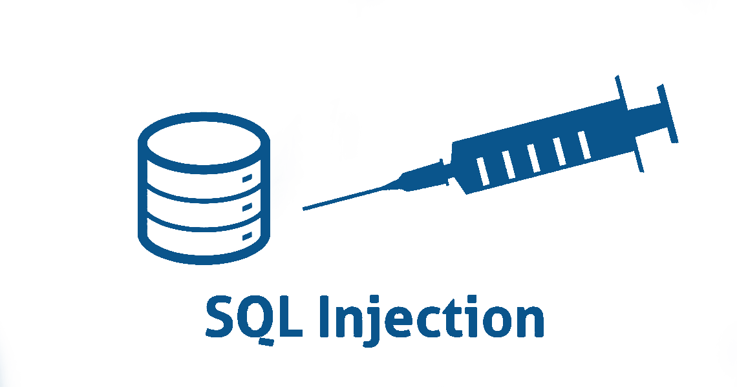
TEAM MEMBERS –
1.) AMBUJ MISHRA – IPG_2014-012
2.) SHESHAN SHENIWAL – IPG_2014-080
3.)SUNIL KUMAR – IPG_2014-117

Slide 2
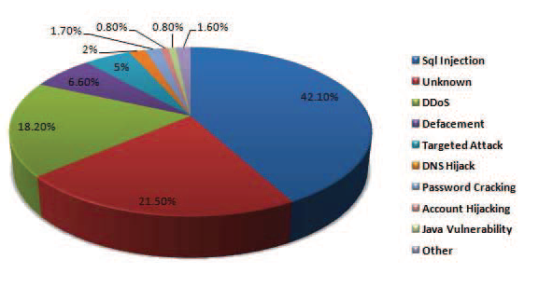
Statistics of various attacks

Slide 3
ABSTRACT
The main consequences of SQL injection includes loss of confidentiality , authentication as the attacker without providing the authentic username and password could successfully obtain access over the network by manipulating the logic of SQL commands.
In this presentation , we broadly focus on the SQL injection introduction , its associated threats , attacks , types ,methodology used by the attacker to implement SQL injection , SQL injection queries and its prevention.

Slide 4
What is SQL Injection ?
SQL Injection can be defined as a technique where hacker executes malicious SQL queries on the database server through web application to either gain access over the sensitive information or on the database.
This is the web based vulnerability which allows attacker to spoof the identity ,destroys the data present on the system and changes the record present on the database.

Slide 5
Threats
Identity Spoofing
Modifying the records resent in the database
Gaining access over administrative privileges
Denial of Service
Attacking machine’s performance

Slide 6
SQL Injection Attacks
Authentication Bypass
Leaking sensitive information
Loss of Data Integrity
Loss of availability of Data

Slide 7
Types of SQL Injection
In-band SQLi (classic SQLi)
a.) Error-based SQLi
b.) Union-based SQLi
Blind SQLi (inferential SQLi)

Slide 8
Union-Based SQLi
In union-based SQLi , a SQL query script is built by concatenating hard coded string with the string entered by the user.
Example of union-based SQLi:-
Input- a’ UNION SELECT table_name,null FROM information_schema.tables#
Query-SELECT userid , name FROM users WHERE id=‘a’ UNION SELECT table_name,null FROM information_schema.tables#’

Slide 9
Blind SQLi
Blind SQLi can be used to obtain access over sensitive information present in the database by asking series of TRUE or FALSE questions through SQL statements.
Example of blind SQLi:-
Input- a’ OR 1=1#
Query-SELECT userid , name FROM users WHERE id = ’a’ OR 1=1#’

Slide 10
Methodology
Step by step methods used by the attacker to implement SQL injection are as following:
Information Gathering
SQL injection Vulnerability Detection
Launch SQL injection attack
Extract the data

Slide 11
SQL Injection Queries
Malicious SQL query:
Input- a’ OR 1=1#
Query-SELECT userid , name FROM users WHERE id = ’a’ OR 1=1#’
Output-This query is always true.If website is vulnerable to SQL injection then attacker without providing the authentic username and password could successfully obtain the access over the network.

Slide 12
SQL Injection Queries
Query for Updating Table :
Input- a’;UPDATE users SET name=‘pqr’ WHERE id=1 #
Query- SELECT userid,name FROM users WHERE userid=‘a’;UPDATE users SET name=‘pqr’ WHERE id=1 #’
Output- This query modifies the name of the user with id 1 to ‘pqr’

Slide 13
SQL Injection Queries
Query for deleting Table-
Input- a’ ; DROP TABLE users ;#
Query- SELECT userid,name FROM users WHERE userid=‘a’; DROP TABLE users ;#’
Output – Through this query the table ‘users’ is droped

Slide 14
SQL Injection Prevention
Minimizing the Privileges
SQL Server Firewalling
We use the following functions which is already defined in PHP -
mysqli_real_esape_string(database connection,query);
stripslashes();

Slide 15
SQL Injection Prevention
example: When user types his/her username and password in this form ("" or ""="“); access should not be granted as it may lead to false negative query result from the database and grant access to intruder or illegitimate user

Slide 16
Conclusion
SQL injection attacks are the major problem for the database, which in turn applied to the web application, which includes the database as a background data controller. Severity levels of attacks are increasing day-by-day with the huge usage of data. SQLi attack is one of the sophisticated methods resulting in great financial loss to an organization when it attacks the sensitive data in the database. It also destroy the data or make it otherwise unavailable, and intruder become administrators of the database server and cause change up to large extent which may be very dangerous for any organisation and can cause heavy loss to that organisation .

Slide 17
Refrences
Research of SQL Injection Attack and Prevention Technology
Li Qian Institute of Information Engineering of Anhui Xinhua University University of Science and Technology.
http://ieeexplore.ieee.org/stamp/stamp.jsp?arnumber=7724789
Enhanced Approach to Detection of SQL Injection Attack
Raja Prasad Karuparthi Department of Computer Science Sam Houston State University
http://ieeexplore.ieee.org/document/7838186/
www.acunetix.com/websitesecurity/sql-injection2/
Wikipedia
https://en.wikipedia.org/wiki/SQL_injection

Slide 18
THANK YOU !

